Slide 1

Retention Rates of Adventure Works Subscribers
By Jessica Baxter for Turnig College

Slide 2
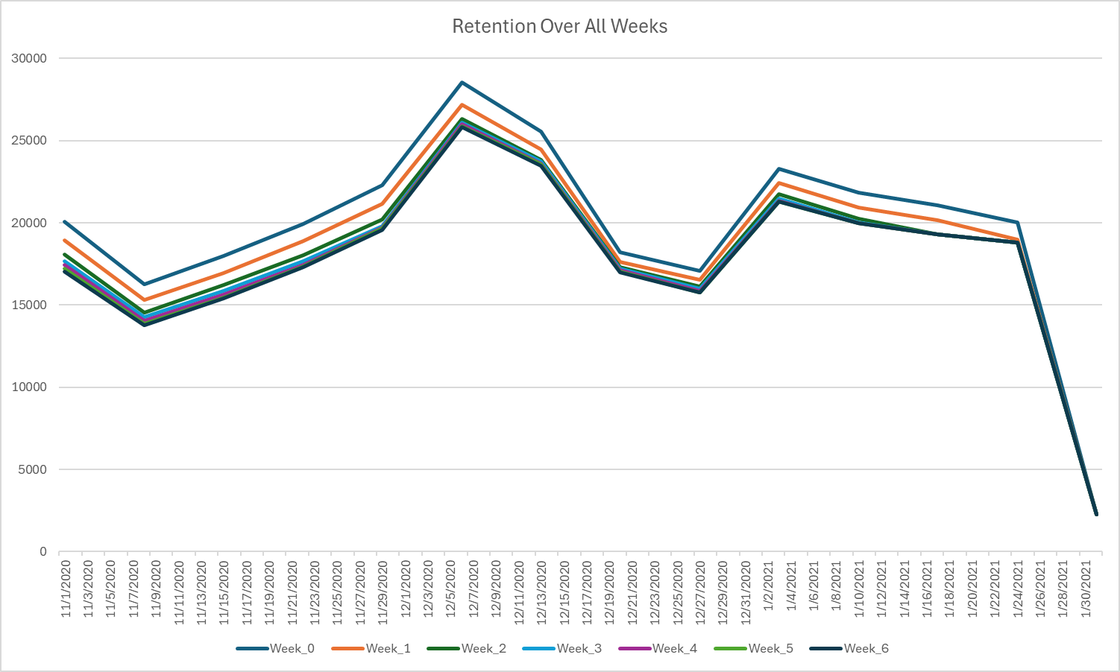
Retention rate over all weeks
Notes:
When charting out retention rates over all week November through January, we can see they run along a very similar pattern. All subscriptions seem to taper off by the end of January. There is a spike in December, possibly due to holiday subscribers or gifted subscriptions, with a dip in subscriptions just after the holidays.

Slide 3
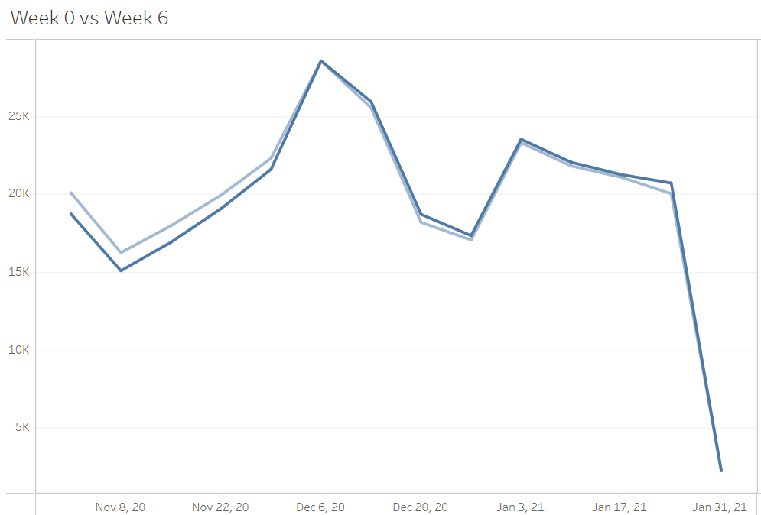
Retention rate Week 0 vs Week 6
Notes:
When comparing retention rate of week 0 (light blue) to week 6 (dark blue) we see they run along a similar path over time, eventually tapering off in January. We can see that the retention rate of week 0 starts off slightly stronger at 20,085 than at week 6 at 17,018.

Slide 4
Percentage Retention rate comparisons
Notes:
When looking at the comparisons of the retention rate in table form, we can see that retention rates decrease over a 6-week period. There is also a lack of data beyond January 31, this leads to retention rates in January being incomplete.

Slide 5
Retention rates overall
Retention Rate seems fairly steady until January, with exception to a spike in December
All weeks for retention are fairly even with each other, there doesn’t seem to be any outliers between the weeks
There seems to be a decline in retention over 6 weeks
Notes:
Read Slide
It would also be good to know reasons for churn vs retention, that might also help explain the spike in December.

